Slide 1
Alberta’s Natural Resources

Slide 2
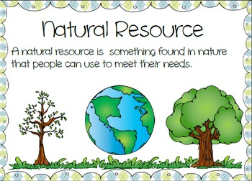
Today I will learn …
Today I will learn how Alberta uses its natural resources.

Slide 3
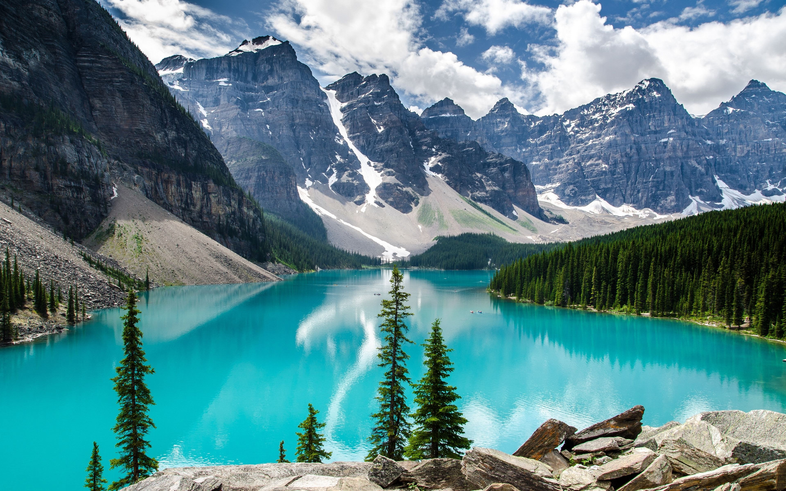
Tourism
Tourism is one of Alberta’s main industries because it has some beautiful mountains and lakes in the Rocky Mountain Region. Many people come to visit and stay in places like Banff, Canmore, Lake Louise, and Jasper.

Slide 4

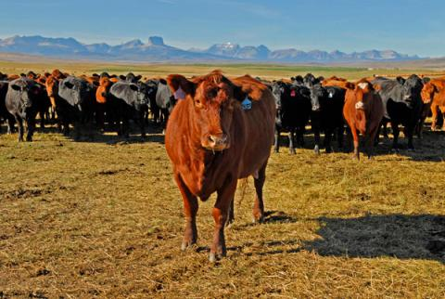
Cattle-farming
The parklands region has great farm land. Many farmers use the farm land to raise cattle. We are known for our Alberta beef.

Slide 5
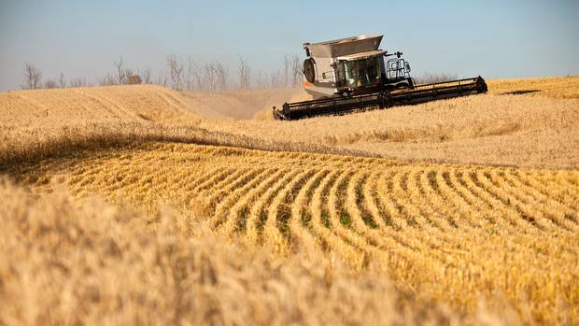
Wheat Farming
The parkland also has good farming for wheat! Wheat farmers sell their wheat to make products like flour.

Slide 6
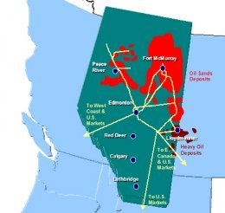
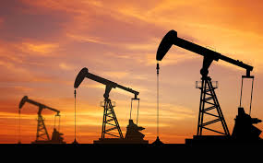
Oil and Gas
Alberta is sitting over top one of the largest oil deposits in the world.

Slide 7
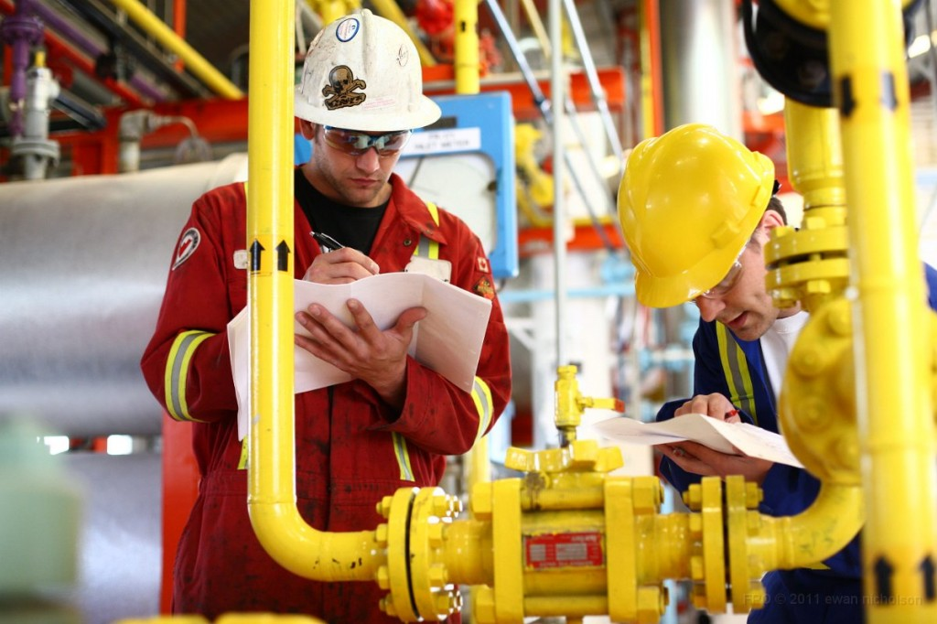
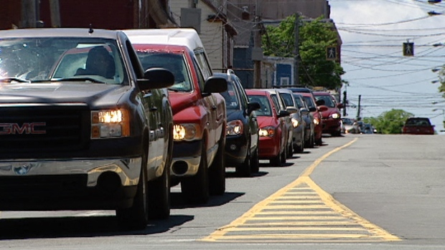
Oil and Gas
The oil and gas industry helps Alberta in many ways:
- Most of our jobs come from there.
- We get energy for our cars and houses from there.

Slide 8
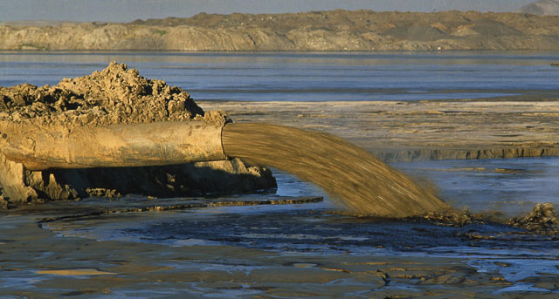
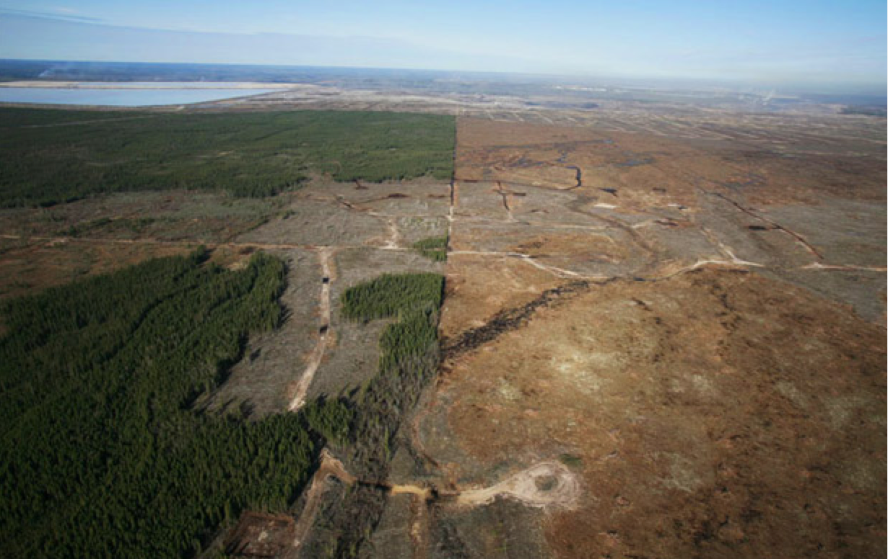
Oil and Gas
There are lots of bad things about the oil and gas industry too. The first is that it damages the environment.
They create tailing ponds with chemicals from the process of making gas. These can kill animals and cause pollution.
They cut down forests to get to oil and gas.

Slide 9
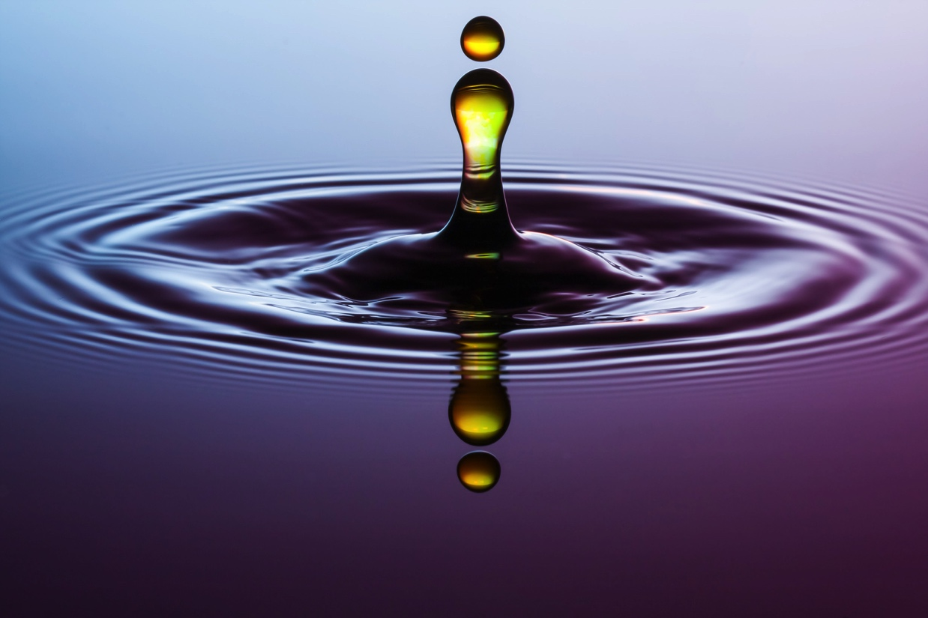
Oil and Gas
It also takes a lot of fresh water to extract oil. It takes even more if they are doing something called fracking. The world only has so much fresh water. There are places without any clean water. We need it to drink.

Slide 10
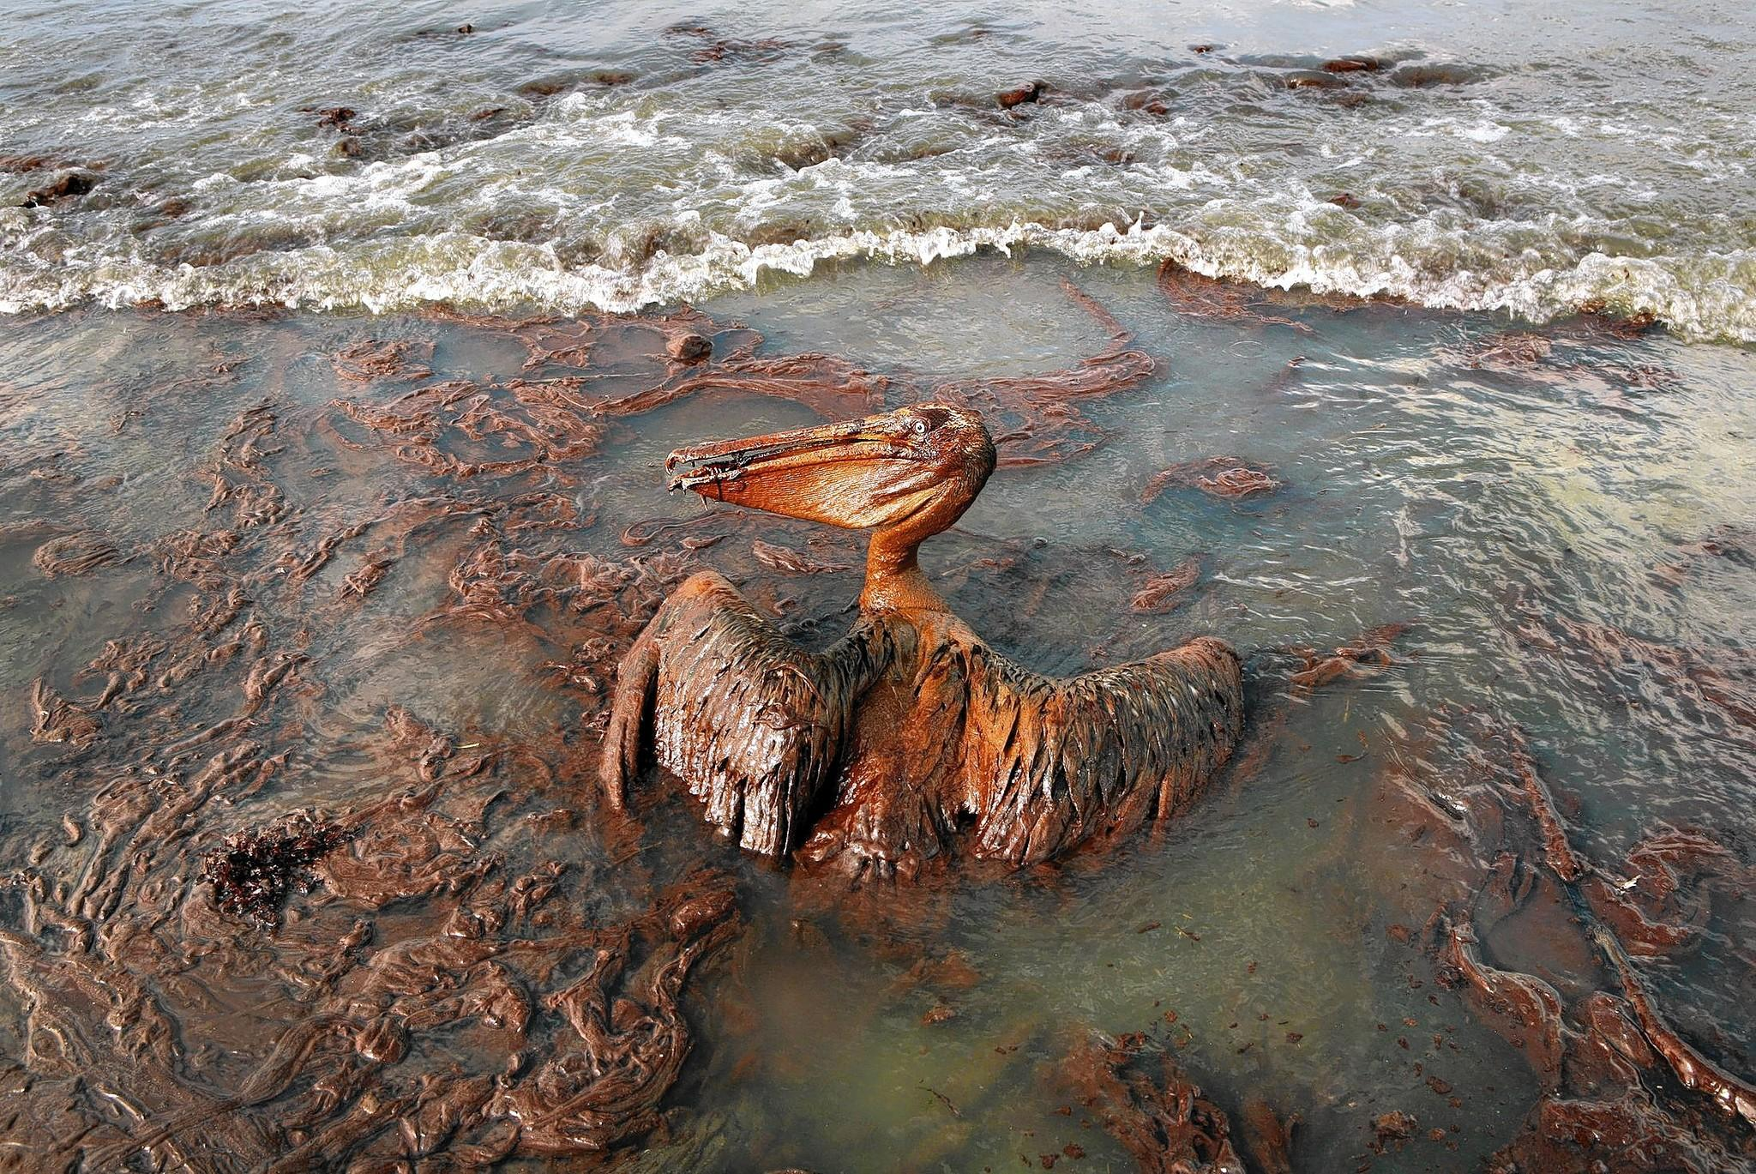
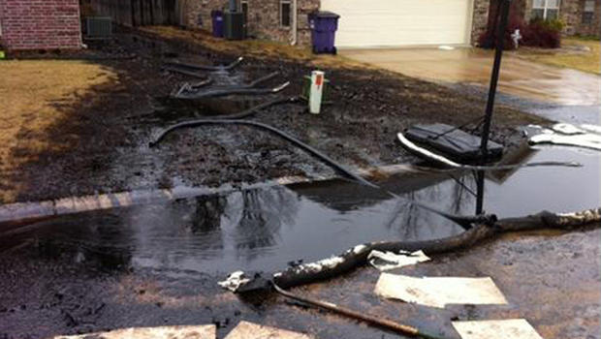
Oil and Gas
Pipelines can leak and trucks and boats can have spills. This happens every so often and causes a lot of damage to the environment.

Slide 11
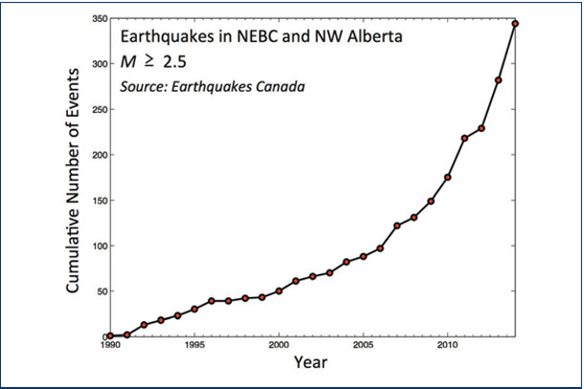
Oil and Gas
Fracking, which is using water and other tools to get oil that is deep down in the earth out of rocks, also causes earth quakes and uses lots of fresh water.

Slide 12
Watch the Video on Oil and Gas in Alberta
What is one thing you learned that you didn’t know before?
http://www.filmsforaction.org/watch/h2oil-animated-sequences/

Slide 13
Discussion:
Alberta gets a lot of its money from oil. That’s why some people argue that we need to keep producing it. Other people argue that we need to take care of the environment more. These people want to find other ways to make energy and money that don’t hurt the environment.
What do you think?

